Slide 1

ANÁLISIS DE DATOS ESPACIALES
EDIER V. ARISTIZÁBAL G.
Ing. Geólogo (Universidad Nacional de Colombia)
Esp. en Gestión de Riesgos Geológicos (Universidad de Ginebra – Suiza)
MSc. en Geociencias (Universidad de Shimane – Japón)
PhD. en Ingeniería (Universidad Nacional de Colombia)
Universidad Nacional de Colombia
Facultad de Minas
Departamento de Geociencias

Slide 2

SUPPORT VECTOR MACHINE

Slide 3

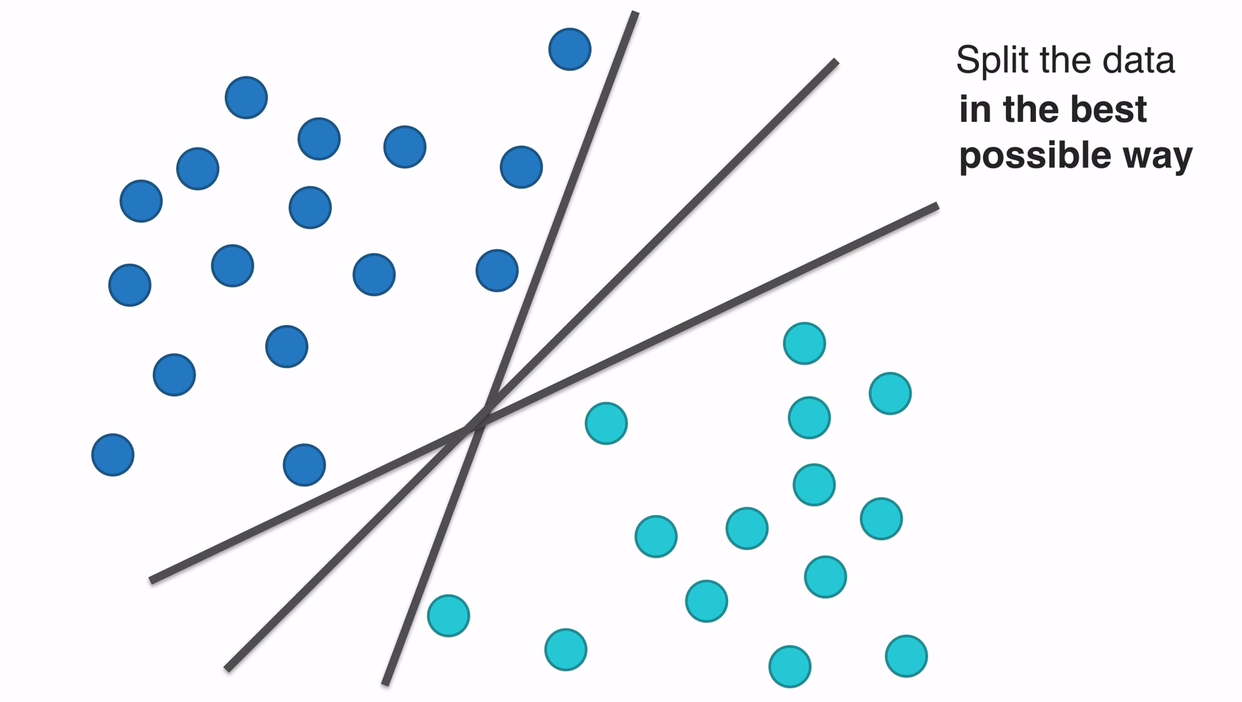
SUPPORT VECTOR MACHINE

Slide 4
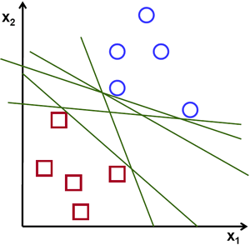

SUPPORT VECTOR MACHINE

Slide 5
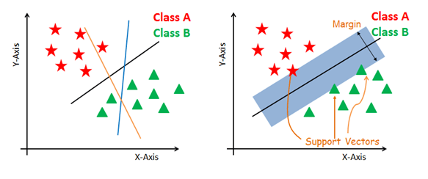
SUPPORT VECTOR MACHINE

Slide 6

SUPPORT VECTOR MACHINE

Slide 7
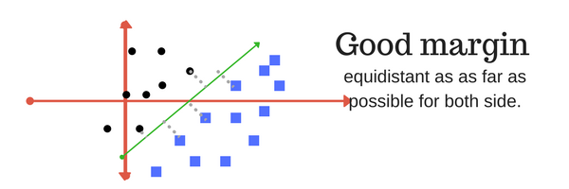
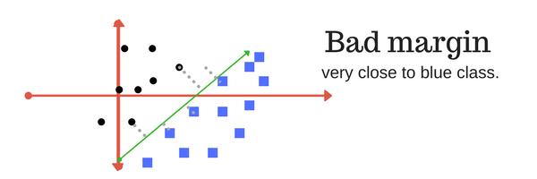
MARGIN
A margin is a separation of line to the closest class points. A good margin is one where this separation is larger for both the classes. Images below gives to visual example of good and bad margin. A good margin allows the points to be in their respective classes without crossing to other class.

Slide 8
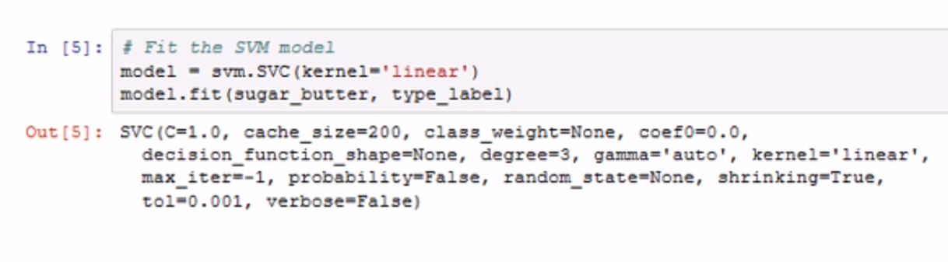
MODELO POR DEFECTO

Slide 9
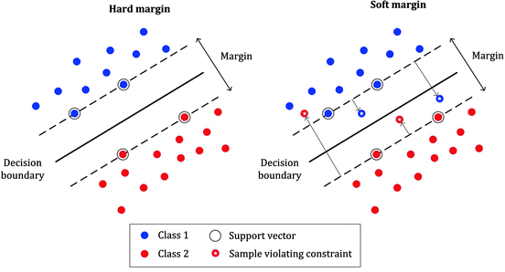
SOFT MARGIN

Slide 10
PARAMETRO C
El parametro C permite definir que tanto se desea penalizar los errores.
A very small value of C will cause the optimizer to look for a larger-margin separating hyperplane, even if that hyperplane misclassifies more points.
The smaller the value of C, the less sensitive the algorithm is to the training data (lower variance and lower bias).
For large values of C, the optimization will choose a smaller-margin hyperplane if that hyperplane does a better job of getting all the training points classified correctly.
The larger the value of C, the more sensitive the algorithm is to the training data (higher variance and higher bias).

Slide 11
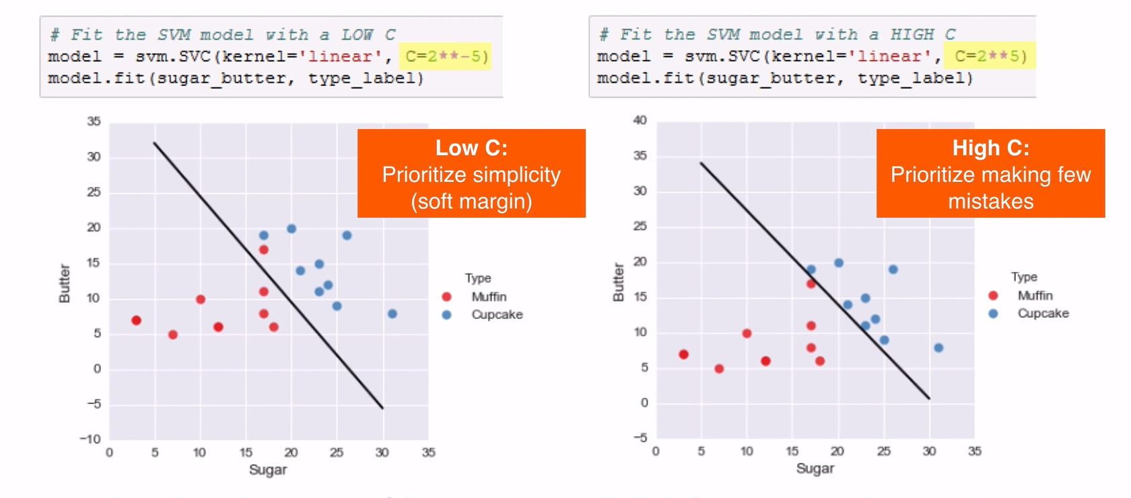
PARAMETRO C

Slide 12
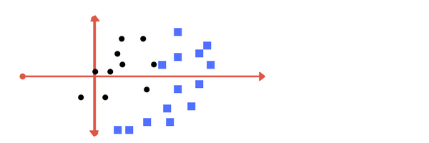
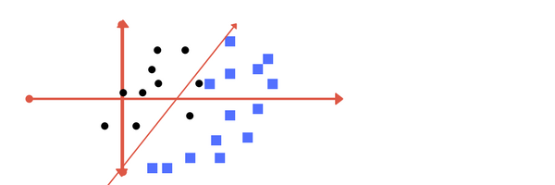
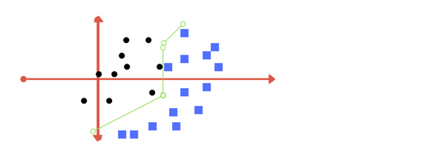
REGULARIZACION

Slide 13
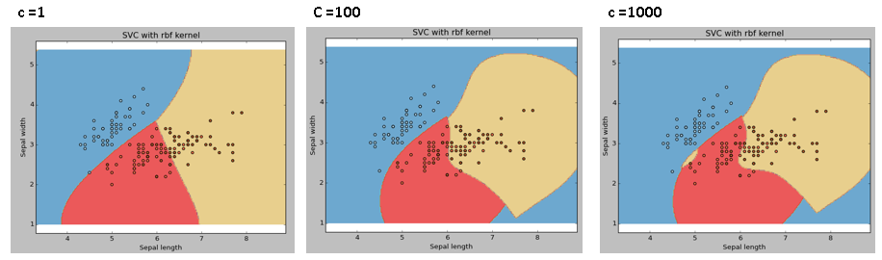
REGULARIZACION

Slide 14
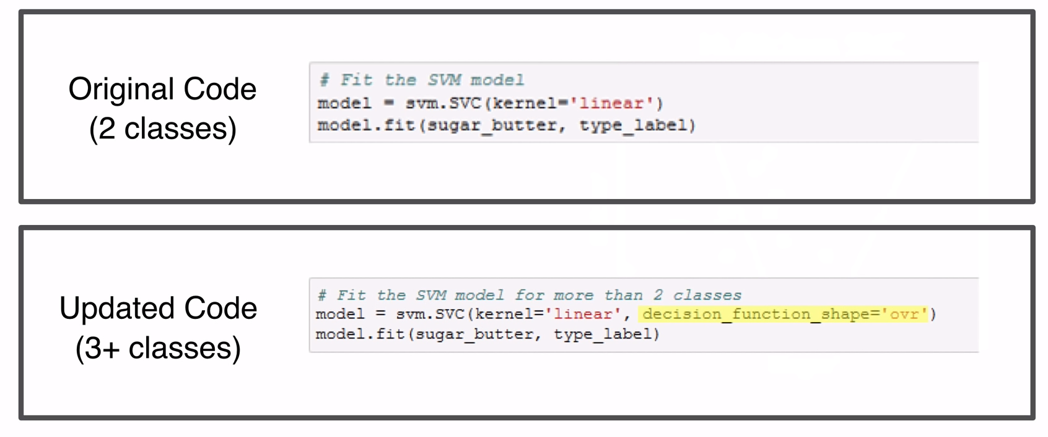
MULTICLASES

Slide 15
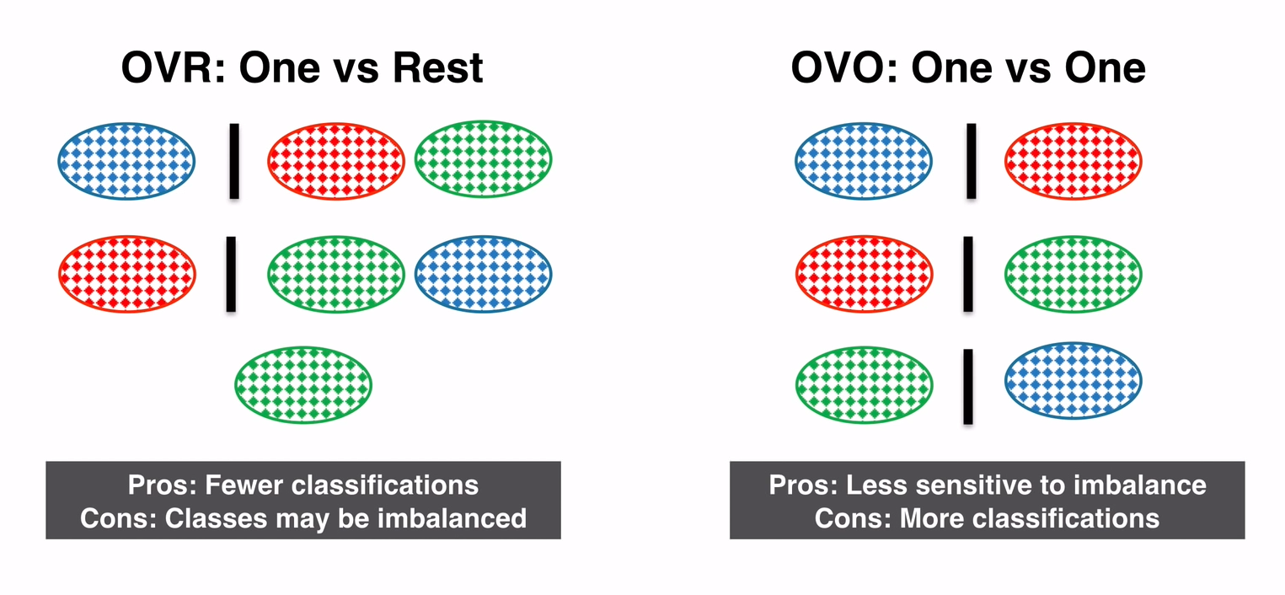
MULTICLASES

Slide 16
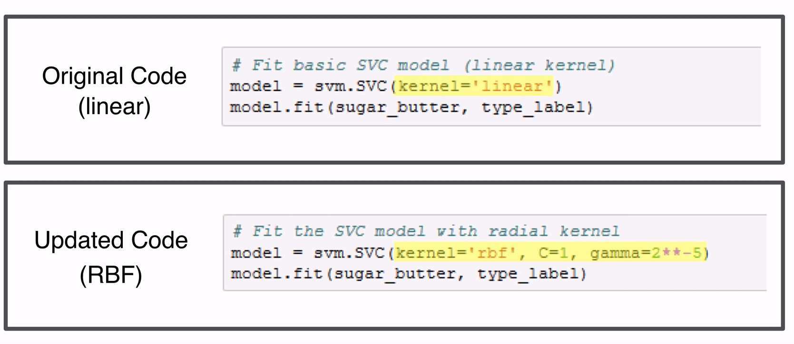
DIMENSIONALIDAD

Slide 17
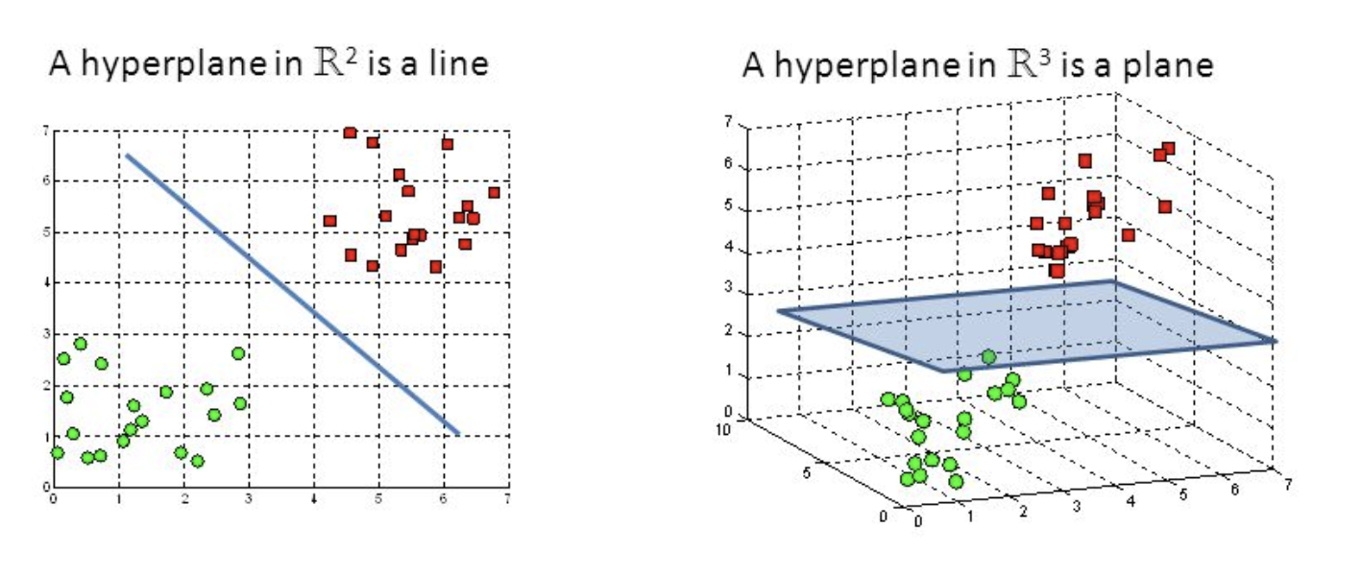
DIMENSIONALIDAD

Slide 18
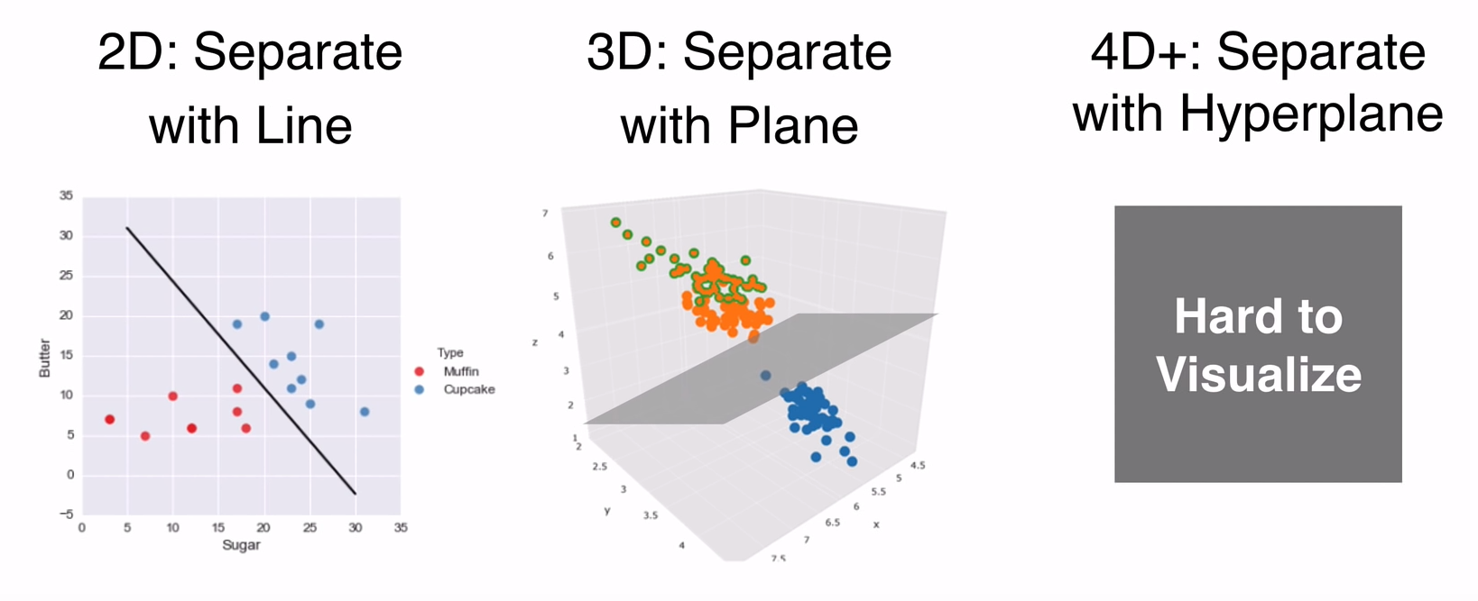
DIMENSIONALIDAD

Slide 19
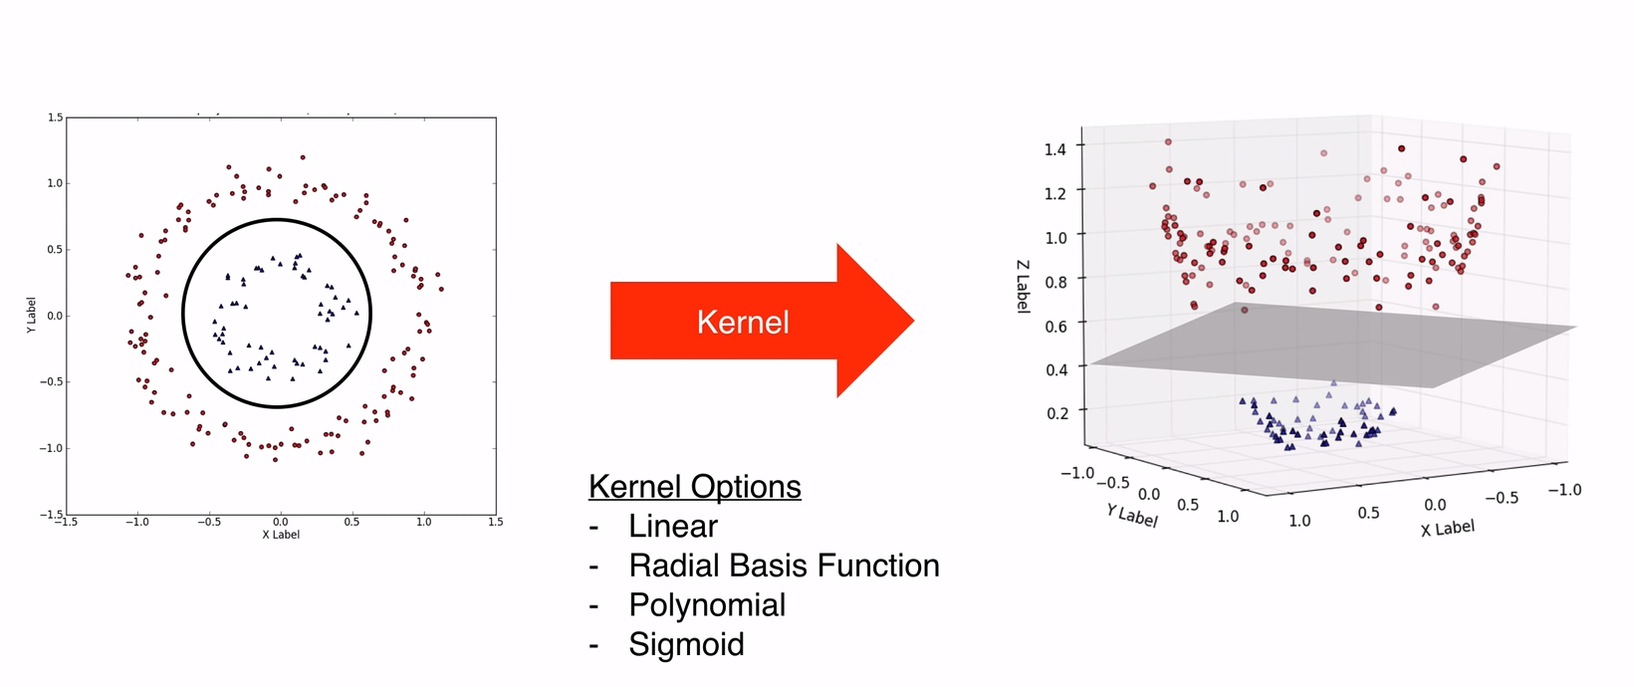
KERNEL TRICK

Slide 20
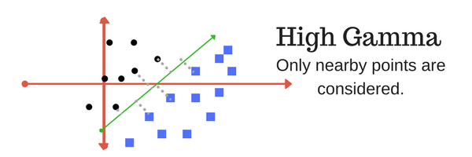
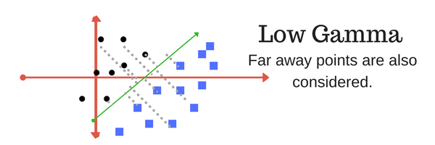
KERNEL TRICK
The gamma parameter defines how far the influence of a single training example reaches, with low values meaning ‘far’ and high values meaning ‘close’. In other words, with low gamma, points far away from plausible seperation line are considered in calculation for the seperation line. Where as high gamma means the points close to plausible line are considered in calculation.

Slide 21
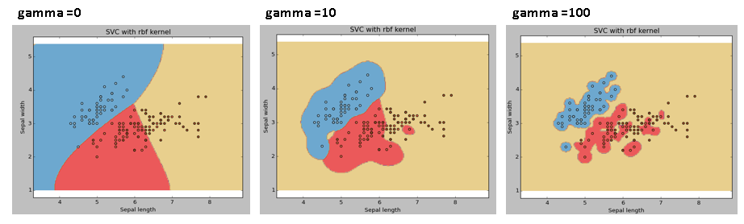
REGULARIZACION

Slide 22
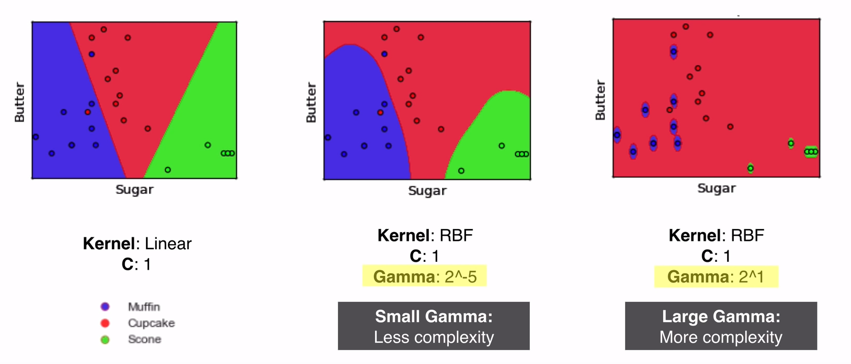
KERNEL TRICK

Slide 23
REGULARIZACION
Pros:
It works really well with clear margin of separation
It is effective in high dimensional spaces.
It is effective in cases where number of dimensions is greater than the number of samples.
It uses a subset of training points in the decision function (called support vectors), so it is also memory efficient.
Cons:
It doesn’t perform well, when we have large data set because the required training time is higher
It also doesn’t perform very well, when the data set has more noise i.e. target classes are overlapping
SVM doesn’t directly provide probability estimates, these are calculated using an expensive five-fold cross-validation. It is related SVC method of Python scikit-learn library.

